Slide 1
Chongqing University of Technology
ATAI
Advanced Technique of Artificial Intelligence
Chongqing University of Technology
A Unified Dual-view Model for Review Summarization and Sentiment Classification with Inconsistency Loss
（SIGIR 2020）
彭展望
代码：https://github.com/kenchan0226/dual_view_review_sum

Slide 2
Outline
Introduction
Related Work
Method
Experiment
Conclusion

Slide 3
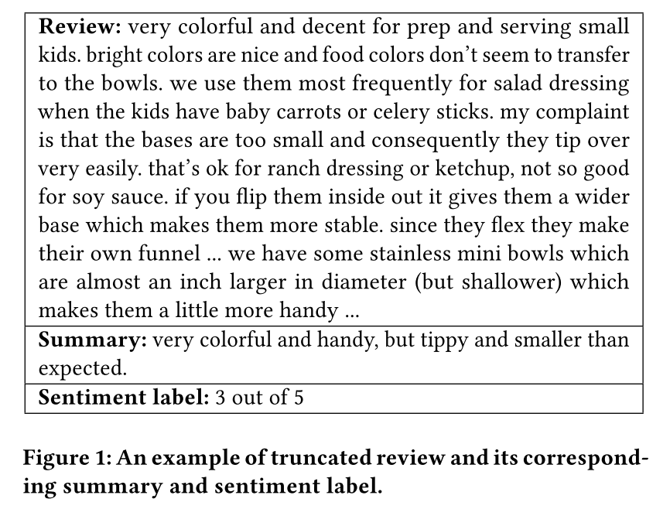
Introduction

Slide 4
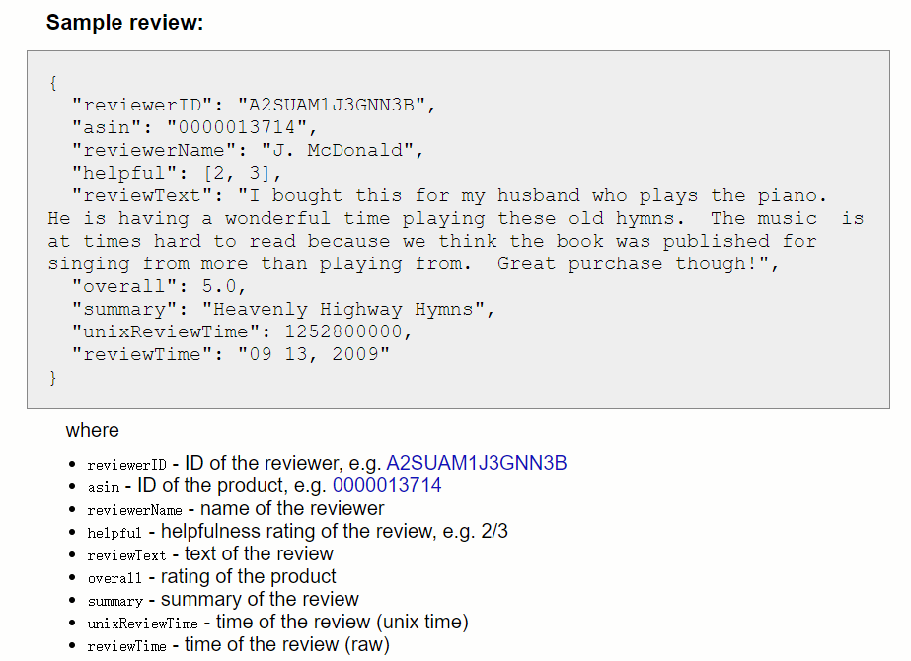
Introduction
Problem Definition:
review text
summary

Slide 5
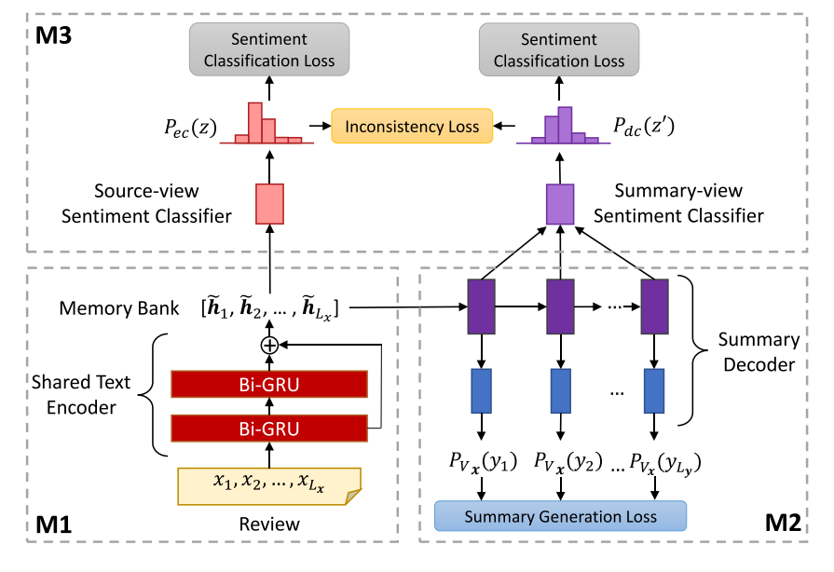
Related Work
M1

Slide 6
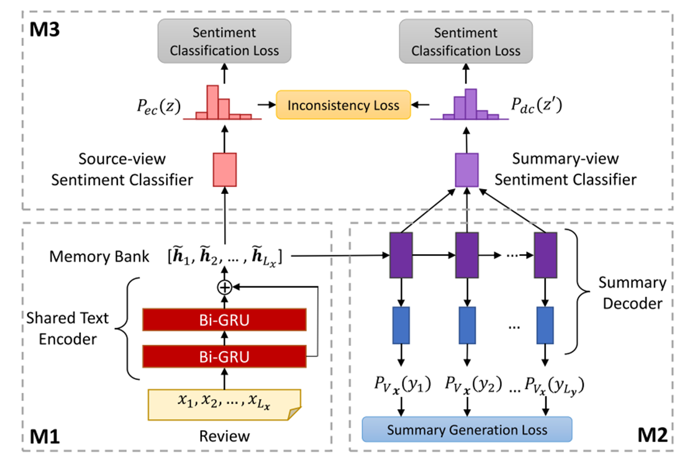
Method

Slide 8
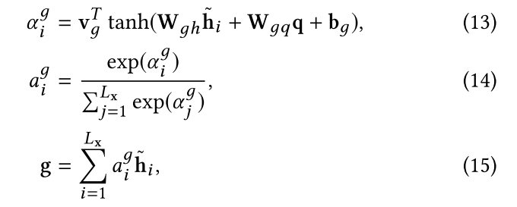
Method
Source-view sentiment classifier
Summary-view sentiment classifier
类似的可以得到：

Slide 9
Method
Inconsistency loss function
The objective function is shown as follows.

Slide 10
Dataset

Slide 11
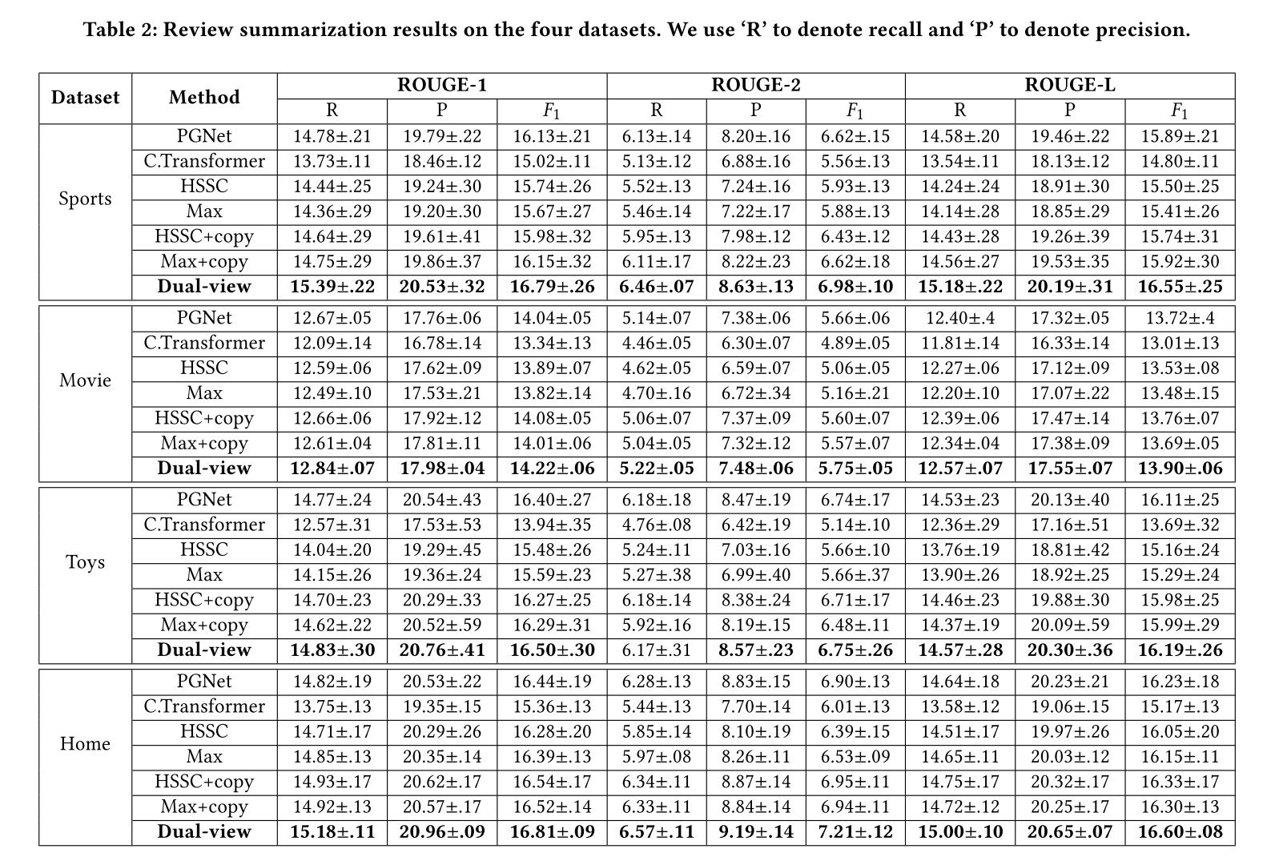
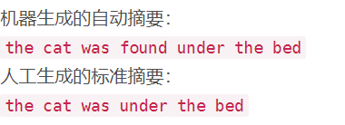
Experiment
ROUGE-1

Slide 12
Experiment

Slide 13
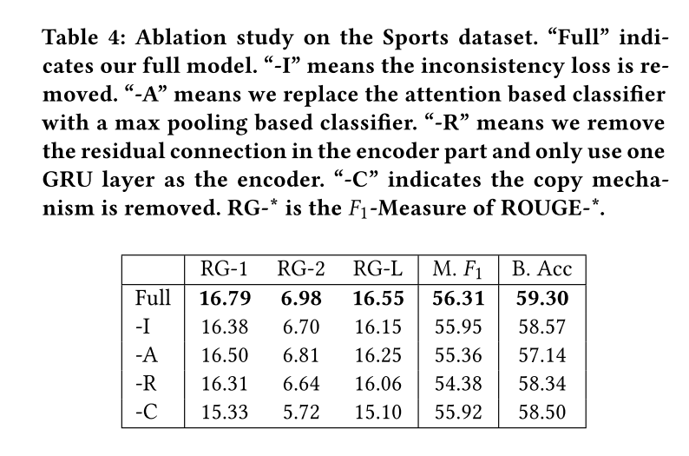
Experiment

Slide 14
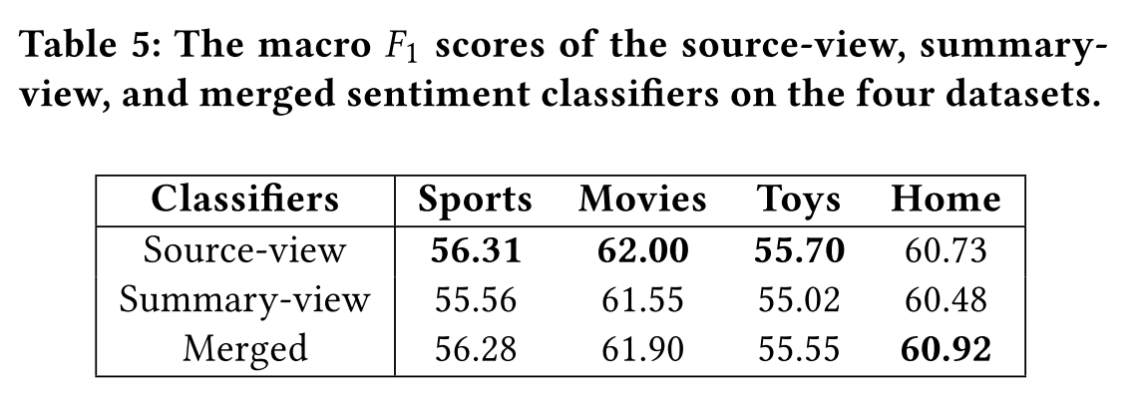
Experiment

Slide 15
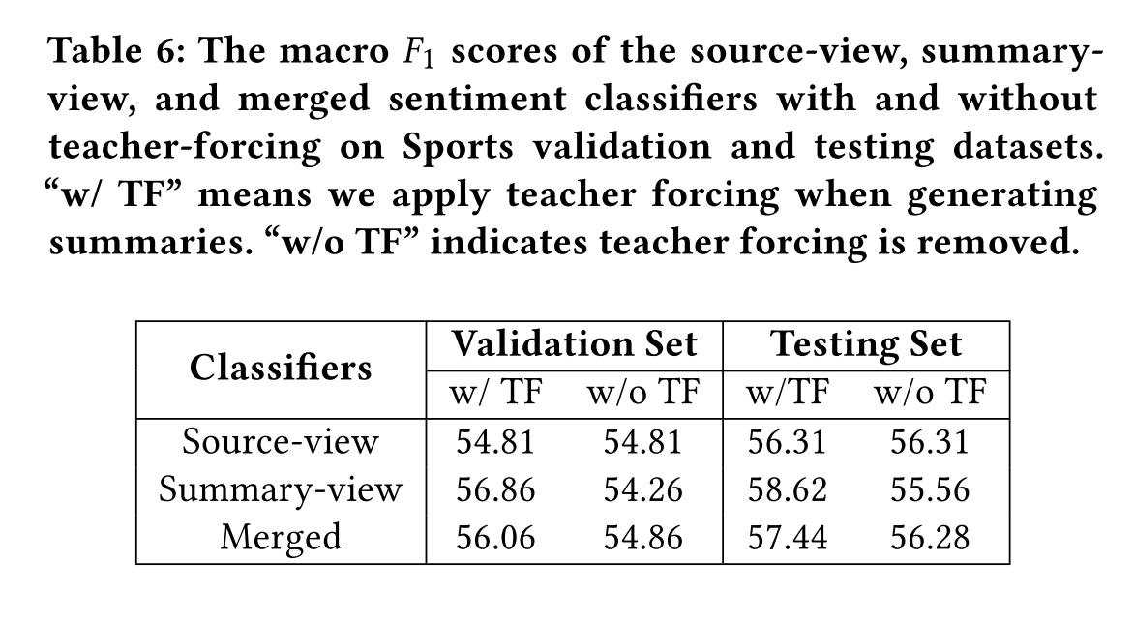
Experiment

Slide 16
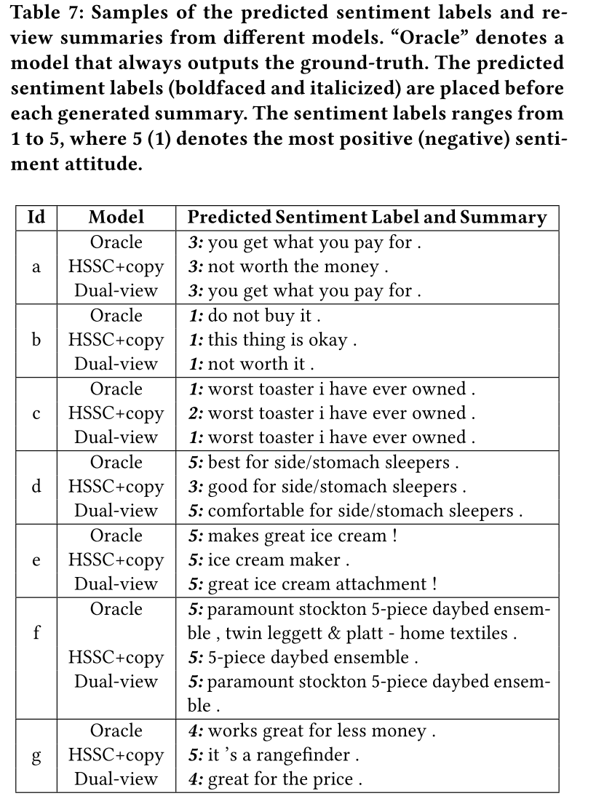
Experiment

Slide 17
Thanks

